Slide 1


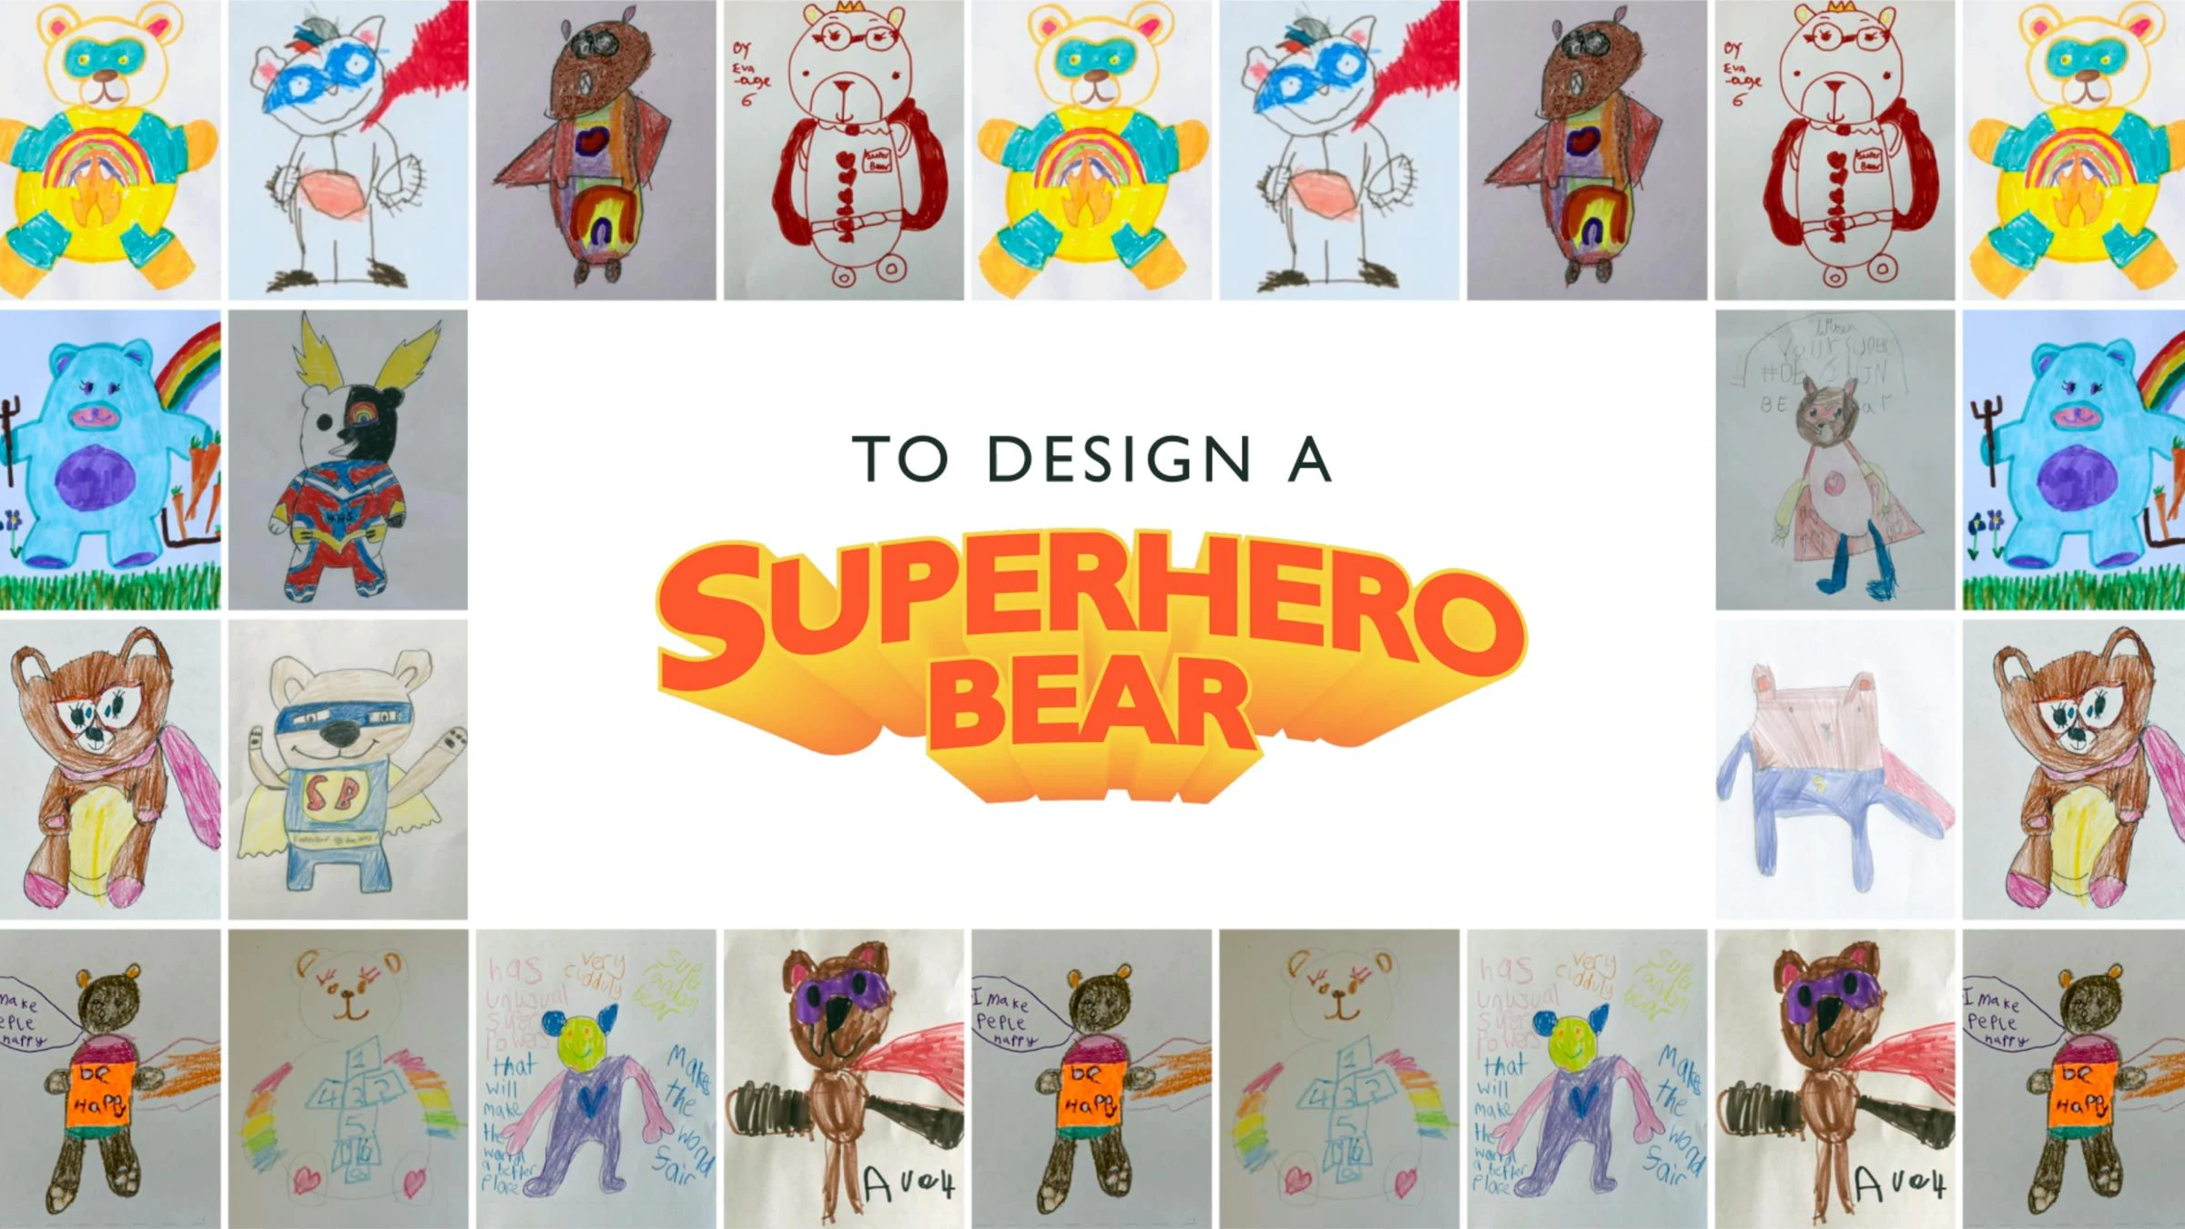
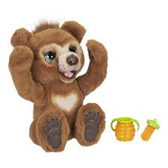
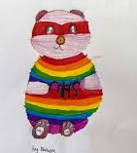
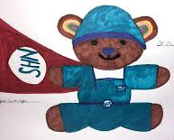
Art Challenge - Week 6
National Competition
John Lewis/Waitrose have launched an exciting competition. They are asking children across the UK to design a superhero teddy bear. The winning design will be made into a real life toy which will be sold in shops at Christmas time. All proceeds from the sales will go to support the NHS.
Follow this link for more information:
https://www.johnlewis.com/content/your-partners-through-it-all/feel-good-friday
Have fun and don’t forget to submit your designs for our school art blog!
Competition deadline 8th May

